Slide 1

Headache Android Application
Well being technology project
Made By: BOUTANE SOUAD and HUMBERTO ENRIQUE DELLA TORRE ESCOBAR

Slide 2
Context of Project
Objectif:
Primary headaches such as migraines are so popular among world wide people, One of the best ways to get relief is to keep track of potential triggers, symptoms, and effective treatment methods.
Mobile applications show great potential for the assessment and registration of information regarding headaches
=> Developing an application that allows migraine patients to maintain a headache diary.
=> The goal is to provide a simple, quick and intuitive way for patients to communicate to their doctors their well-being.

Slide 3
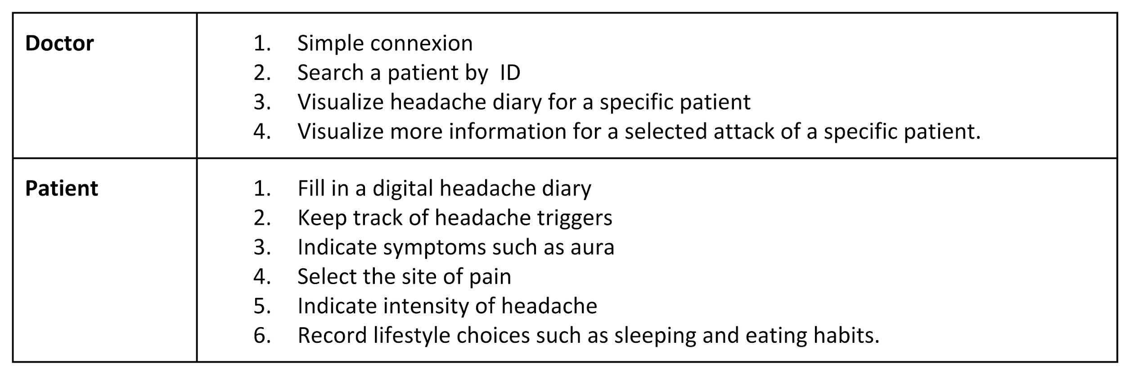
Specifications

Slide 4
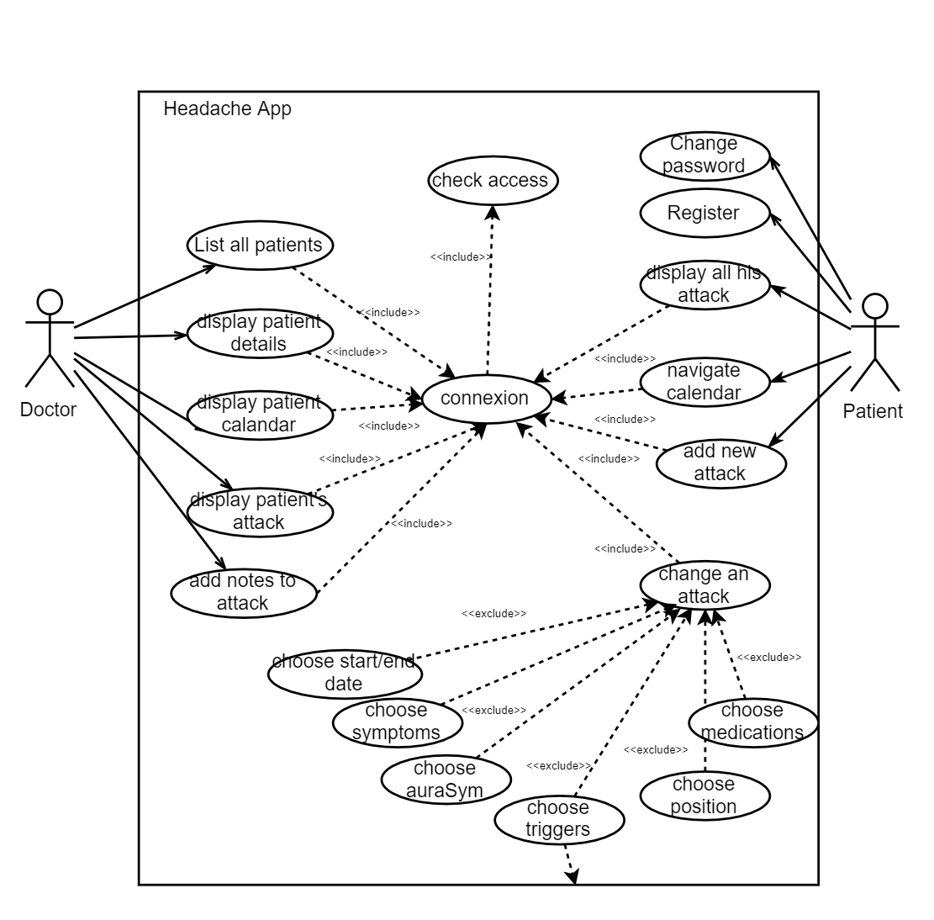
Use Case

Slide 5
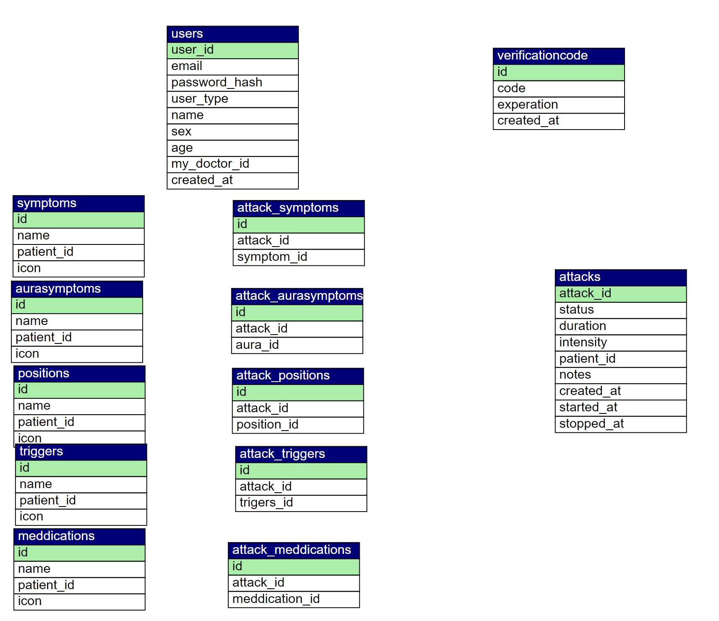
DataBase

Slide 6
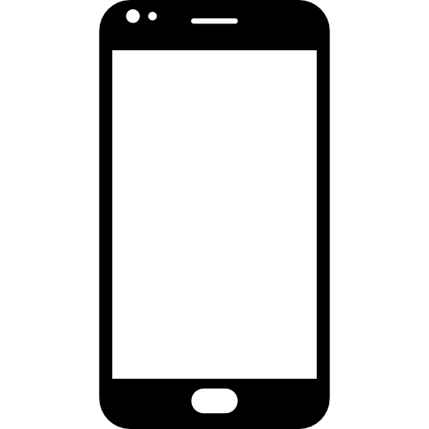
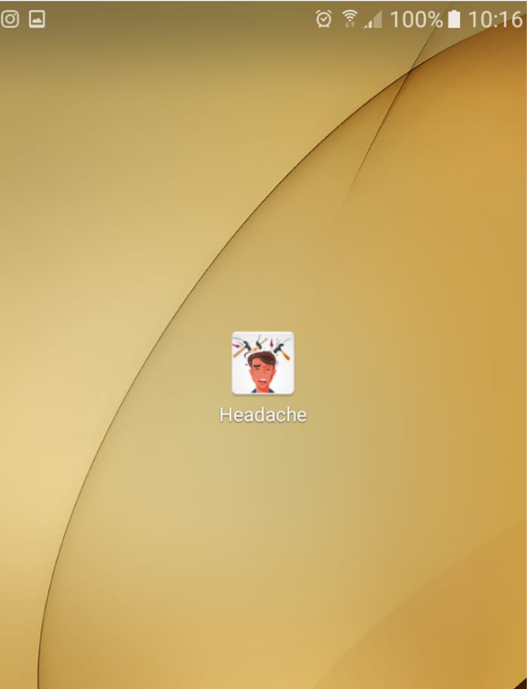


Architecture
App Server/REST API
User
queries
Slim
Controller
Internet
Attack queries
Mobile Device

Slide 7




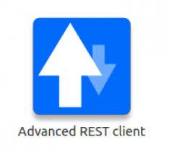

Technologies
Android Studio
Retrofit

Slide 8
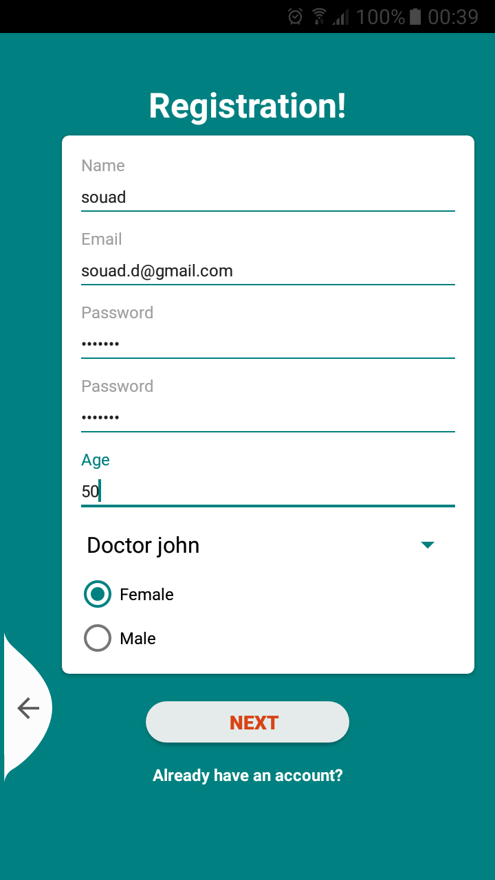
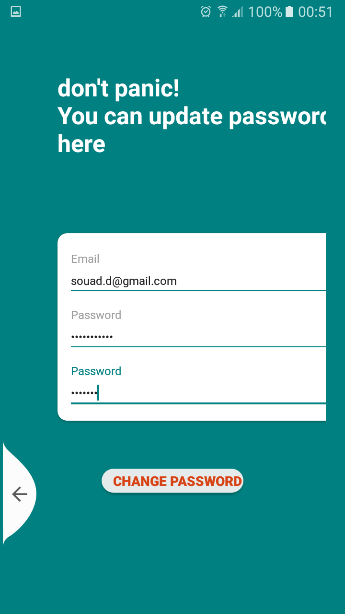
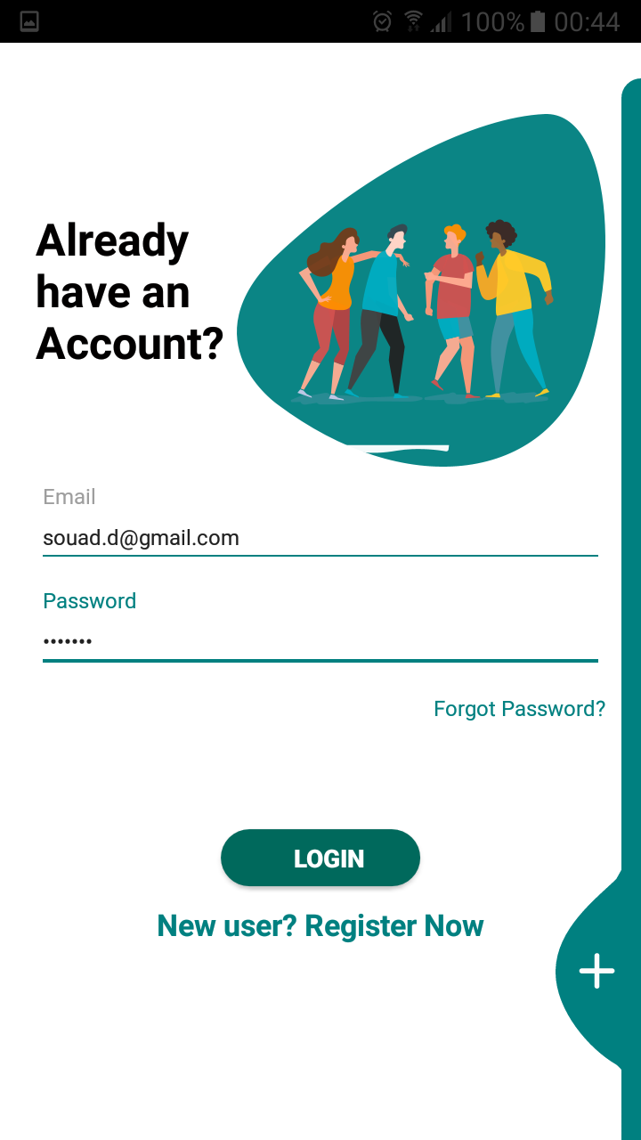
Realisation | Authentication
Register
Forgot password
Login

Slide 9
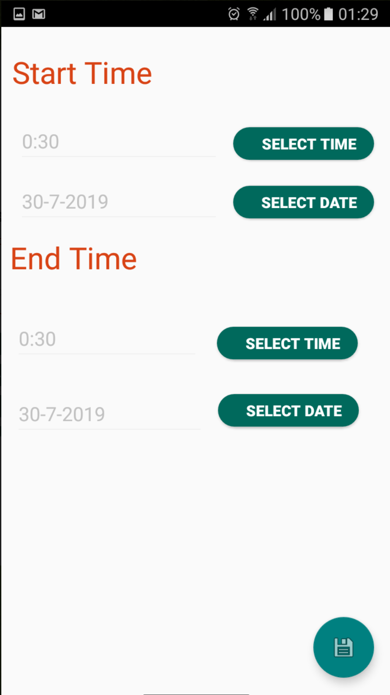
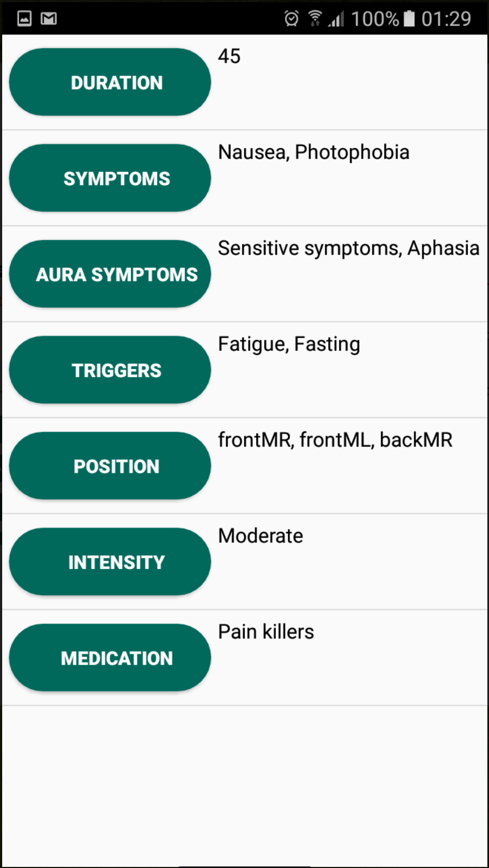
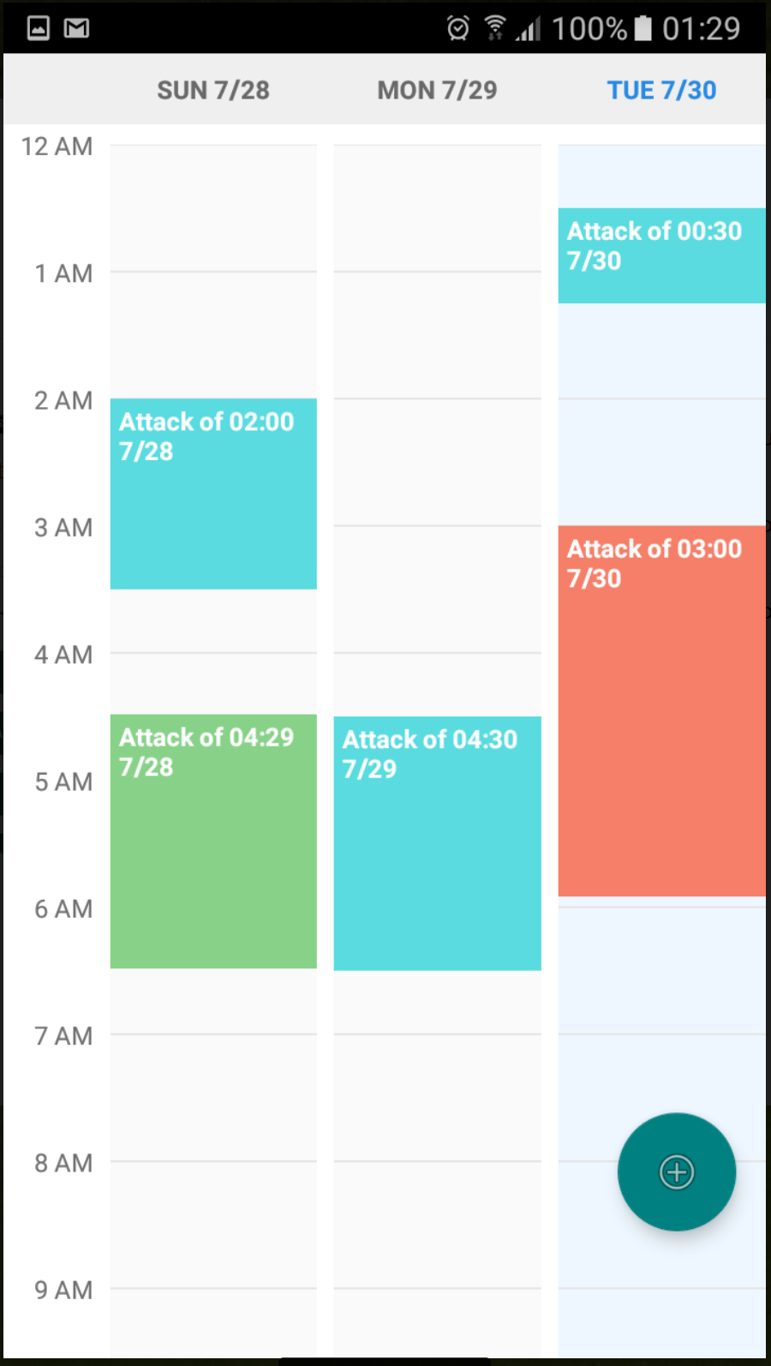
Realisation | Patient
New Attack
Attack details
Calendar

Slide 10
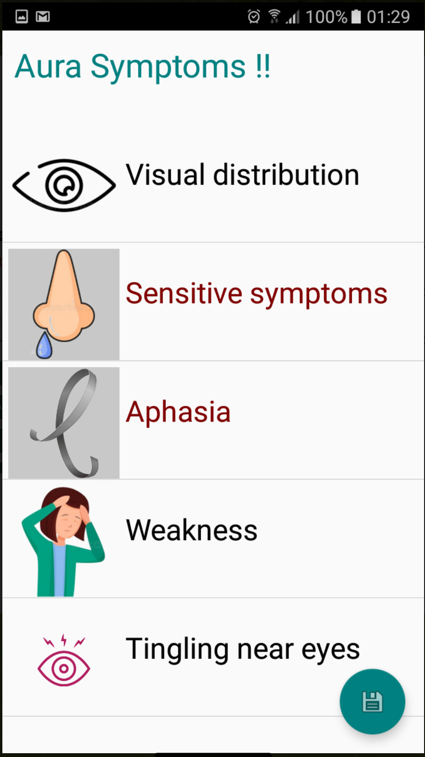
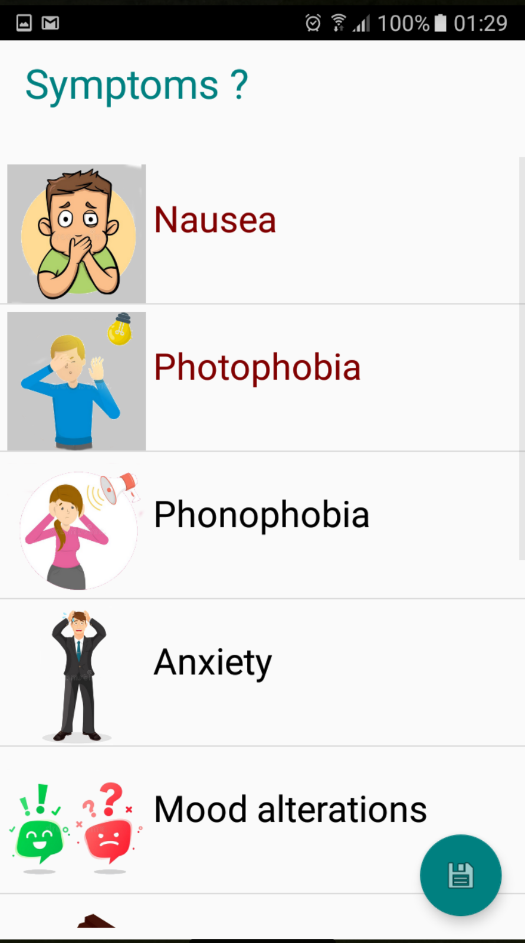
Realisation | Patient
Update attack Aura Symptoms
Update attack symptoms
Update attack time

Slide 11
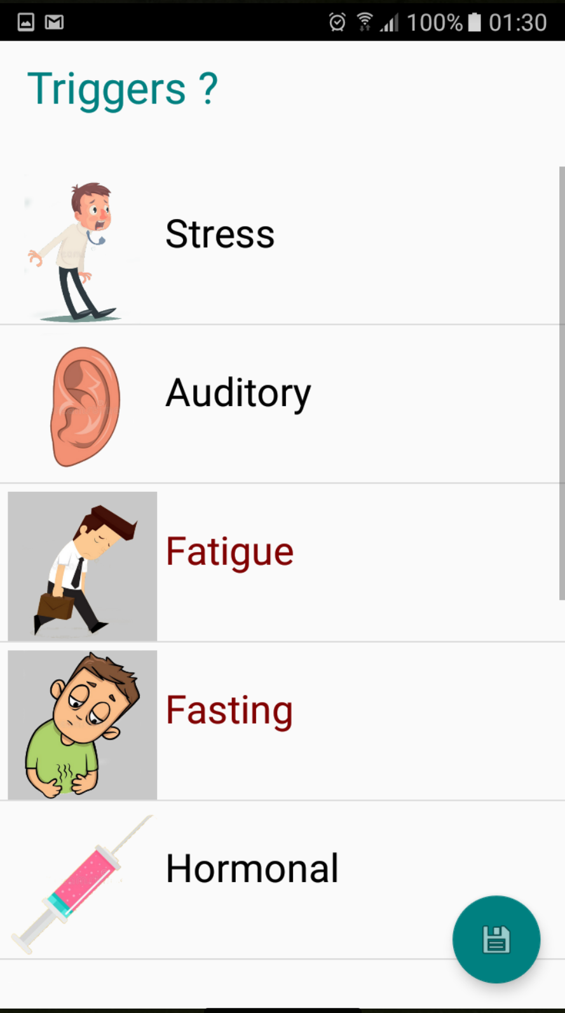
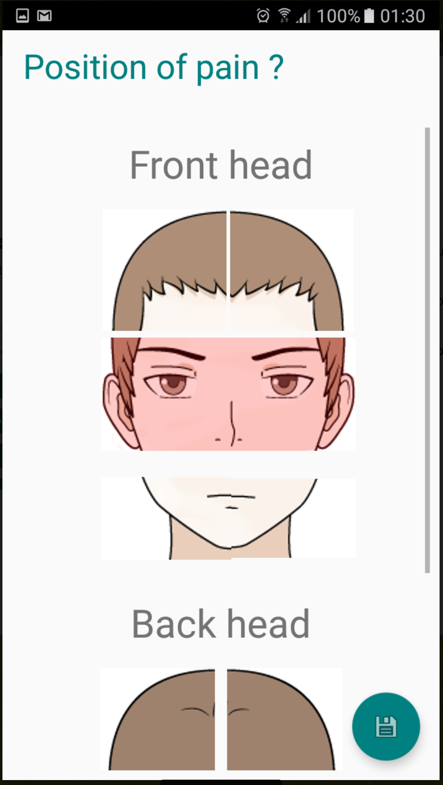
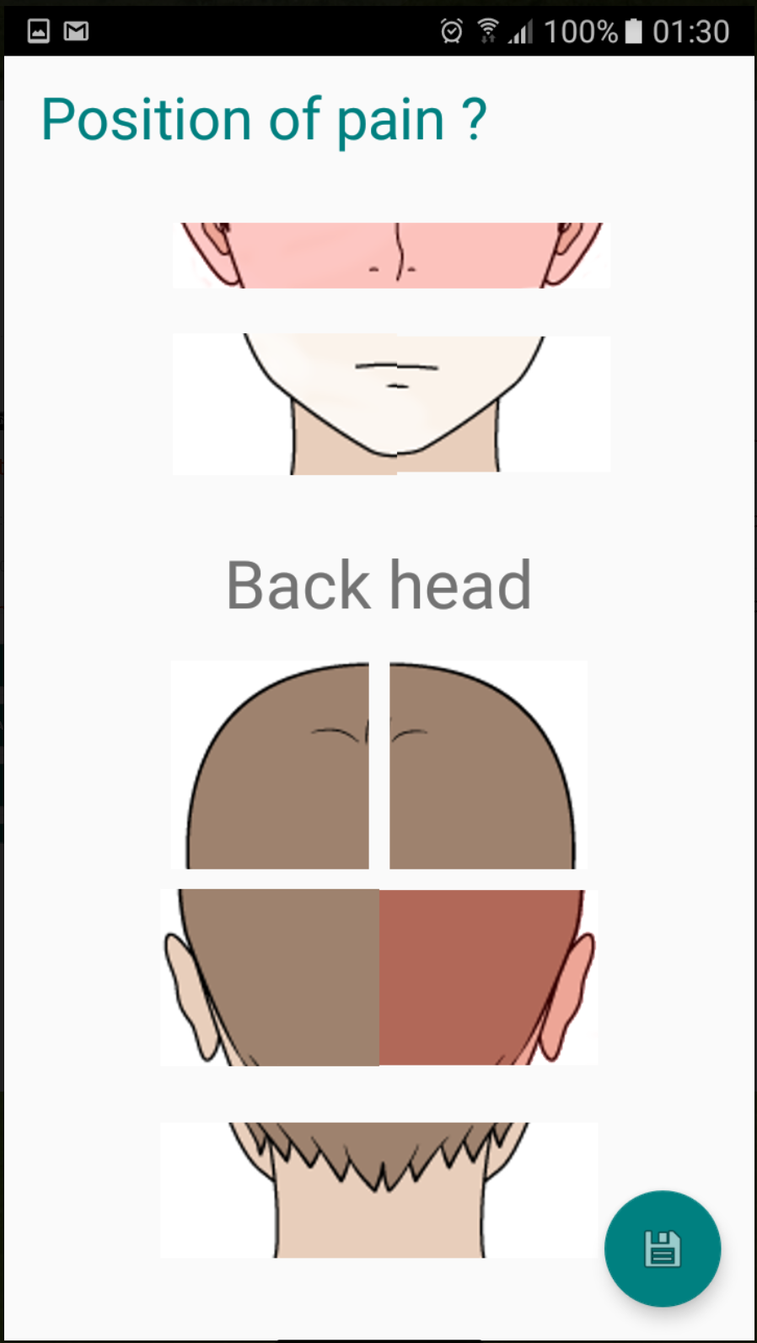
Realisation | Patient
Update attack triggers
Update attack position

Slide 12
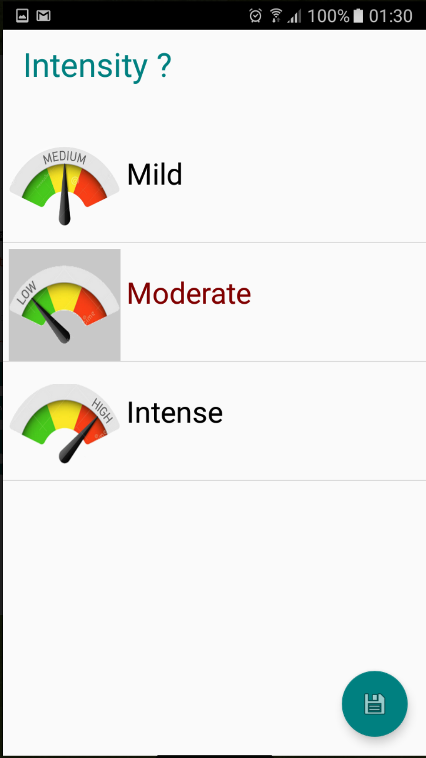
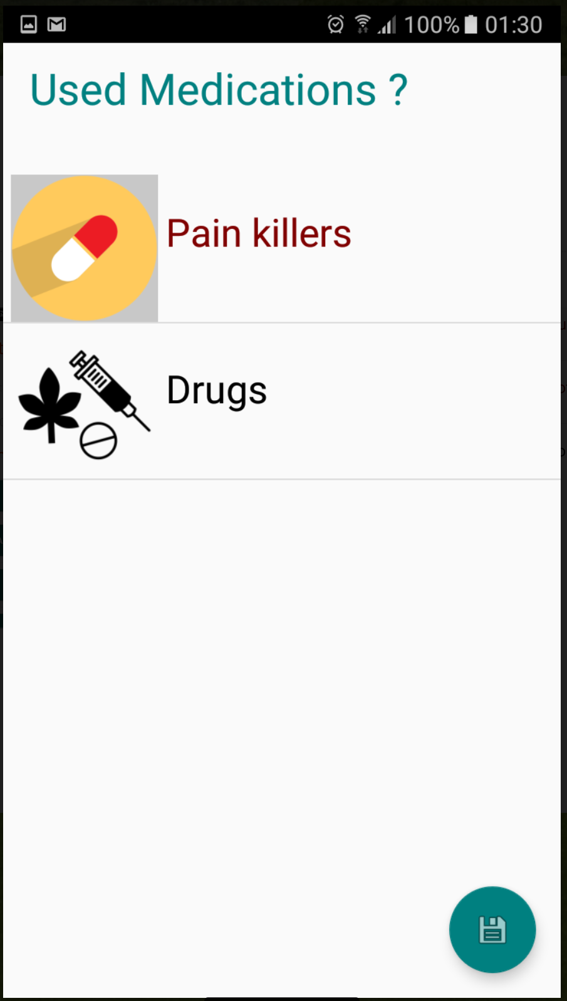
Realisation | Patient
Update attack Intensity
Update attack medications

Slide 13
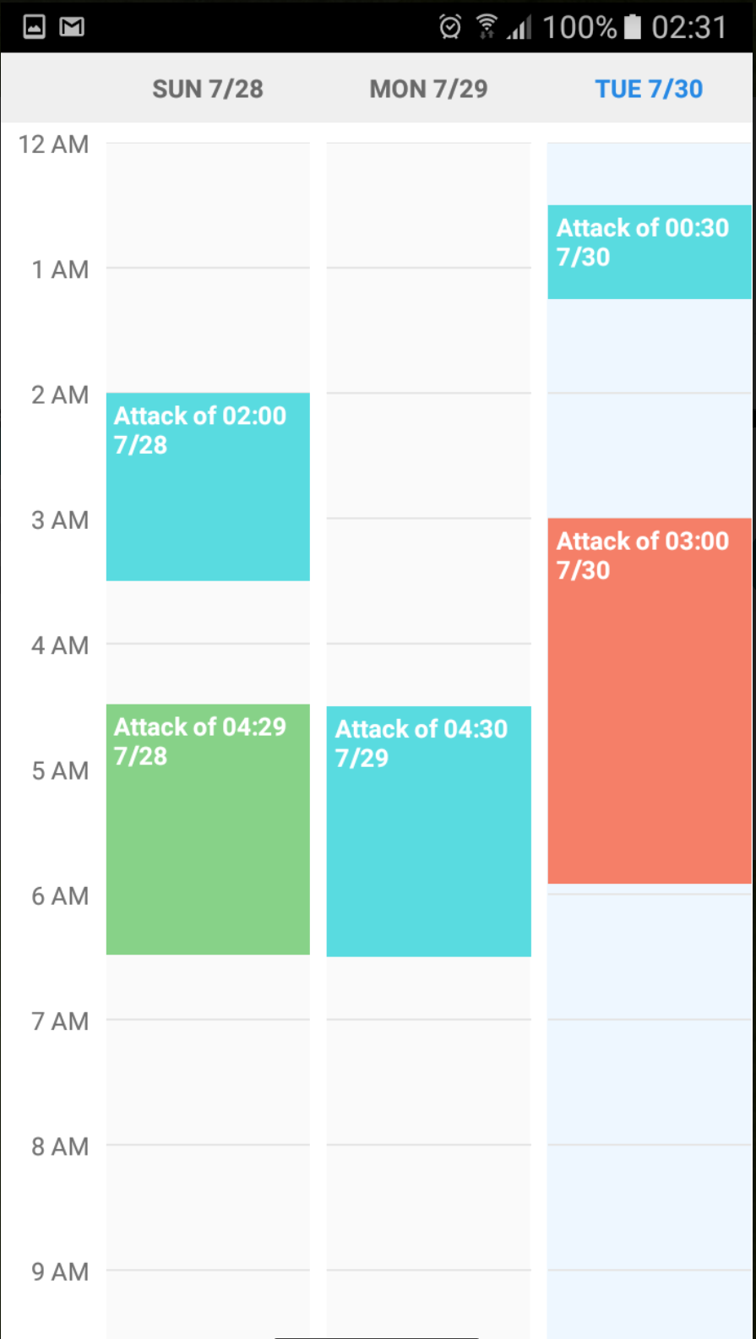
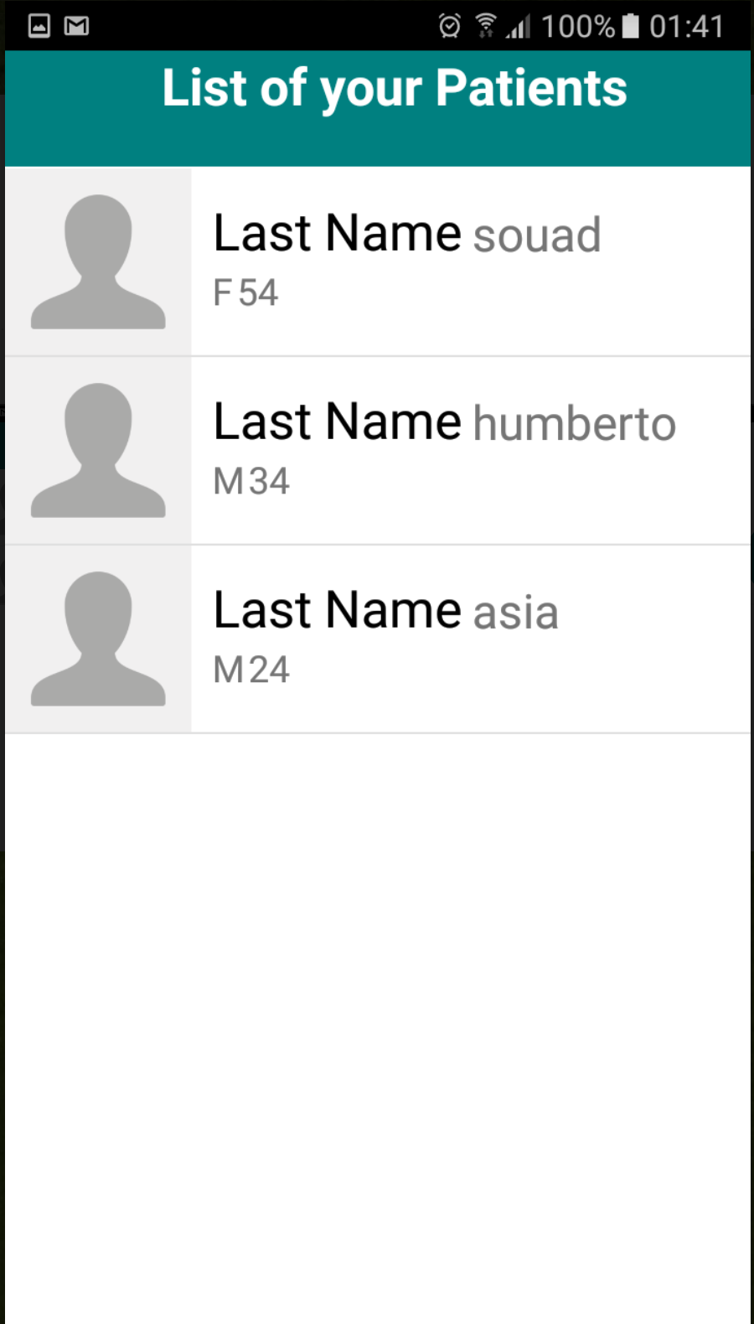
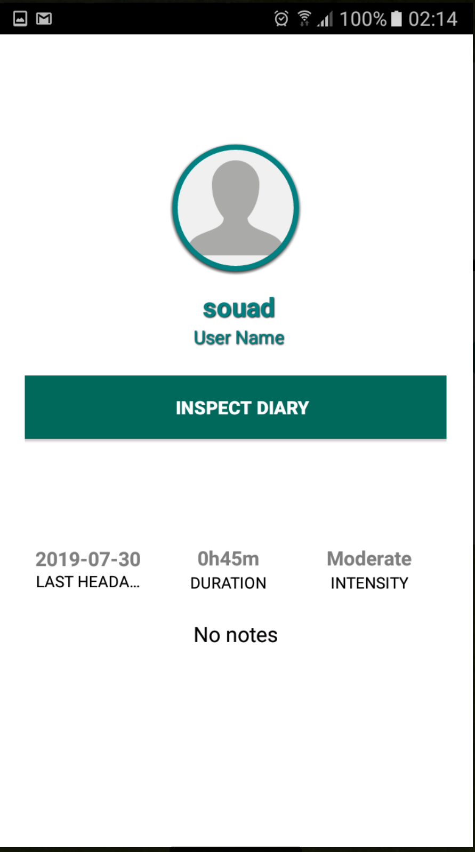
Demonstration | Doctor
Patient calendar
List patients
Patient details
click
Long click

Slide 14
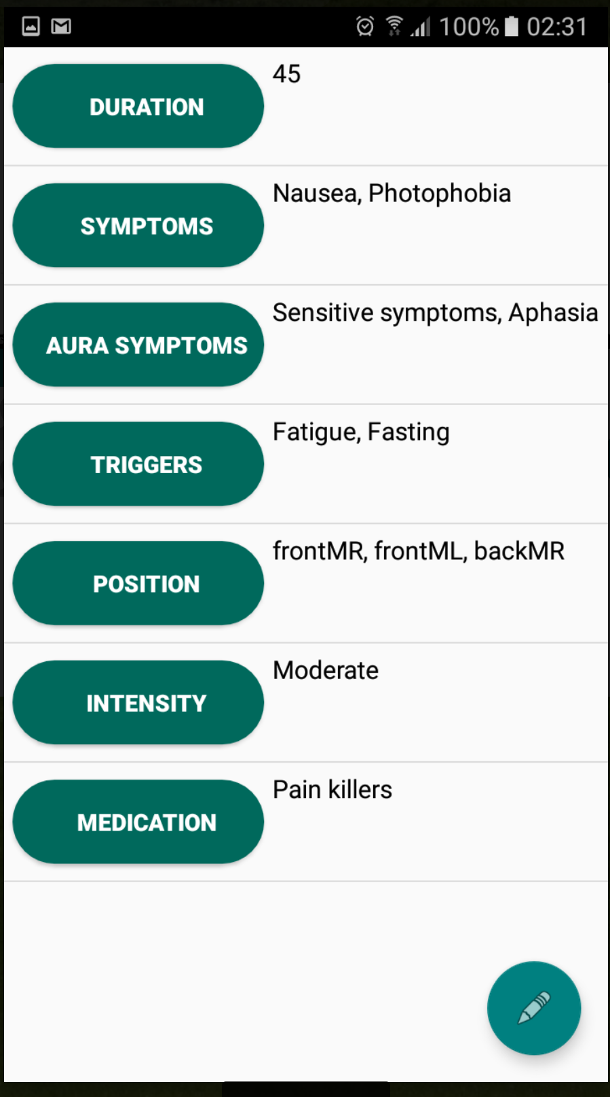
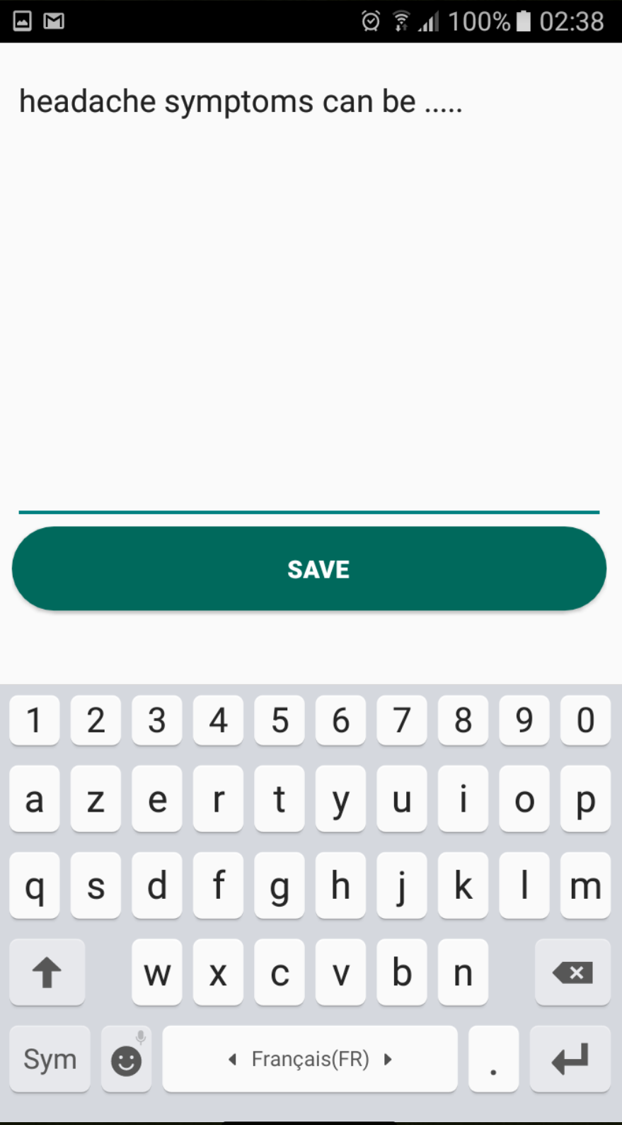
Demonstration | Doctor
Display attack details
Add notes

Slide 15
Headache Android Application
Well being technology project
Made By: BOUTANE SOUAD and HUMBERTO ENRIQUE DELLA TORRE ESCOBAR

